Slide 1
Shyam Sundar Domakonda
Tejesh Bathula
Mani Venkata Sai Pavan Ramisetty
Nahid Fathima Syed
Sasi Kiran Katamneni
Group – 4
INFO 5082 Spring 2024

Slide 2
Medication Outcome Prediction in Major Depressive Disorder through Custom CNN
Our aim is to design a computationally efficient CNN model that demonstrates high performance on Major Depressive Disorder (MDD) EEG signal databases. This will be achieved through the exploration of various time-frequency methods, including Wavelet Synchro Squeezing (WSST), Continuous Wavelet Transform (CWT), and Discrete Wavelet Transform (DWT) to convert EEG signals into time-frequency images. Through this approach, the objective is to enhance the model's ability to accurately analyze EEG signals associated with MDD.

Slide 3
Agenda
Title
Motivation
Background
Abstract(Problem statement)
Literature Survey
Objectives of the Study
Data Set and Data Processing
Research Design(Blueprint/Workflow)
Model Description
Data Visualization and Results
Conclusion
References

Slide 4
Motivation
To Classify individuals as medication responders or non-responders using EEG data to address the critical requirement for accurate MDD therapy prediction.
Explore the Wavelet Synchro squeezing Transform in addition to existing time-frequency techniques like CWT and DWT to increase the precision of the medication outcome prediction using EEG signals.
Developed a custom CNN model that outperforms current hybrid and transfer learning models in terms of computational effectiveness.
Evaluated model performance in order to improve prediction power for MDD medication outcomes using measures including Accuracy, F1 Score, and AUC.

Slide 5
Background
There are more than 300 million cases of Major Depressive Disorder (MDD) worldwide, which highlights the necessity for efficient treatment.
Predictive methods such as EEG analysis are necessary because of the wide variations in medication effectiveness.
Using its simplicity and cost, EEG data is utilized to predict responses to medications based on brain activity during rest.
Advanced time-frequency techniques like DWT, CWT, and Wavelet Synchro squeezing are used in research to analyze EEG data.

Slide 6
Statement of the Project
The goal of this research is to identify responders and non-responders utilizing EEG-based Time-Frequency image techniques, namely the Wavelet Synchro squeezing Transform, to solve the difficulty of predicting drug outcomes in patients with Major Depressive Disorder.
For high performance and computational efficiency, Convolutional Neural Network (CNN) model is created, and comparison analyses are conducted with other Time-Frequency techniques such as Discrete Wavelet Transform (DWT) and Continuous Wavelet Transform (CWT).

Slide 7
Literature Survey
Mumtaz et al. 2017 extracted time-frequency information from EEG signals using three distinct time-frequency techniques: wavelet transform (WT), short-time Fourier transform (STFT), and empirical mode decomposition (EMD). MDD patients were then categorized as responders (R) and non-responders (NR). Employed logistic regression classifier achieved an accuracy of 91.6%.
Ahmad Shalbaf et al. 2021 developed a deep TL approach to predict patients' reaction to SSRI antidepressants using pre-trained CNNs. DenseNet121, the top-performing model, with an accuracy of 95.74%. Moreover, an ensemble model that included many TL layouts reached 96.55% accuracy.
Mohsen Sadat Shahabi et al. 2023 developed a hybrid model based on transfer learning (TL) of pretrained deep CNNs with bidirectional long short-term memory (BLSTM) cells and attention mechanism for classifying R and NR. Converted EEG signals to third-order and fourth-order tensors to facilitate the model's training process. The TL-LSTM-Attention model achieved an accuracy of 98.21%. Additionally, an ensemble model reached an accuracy of 98.84%.

Slide 8
Objectives of the Study
To develop a computationally efficient and high-performing CNN for predicting medication outcomes in patients with MDD, specifically focusing on classifying responders and non-responders.
Research is to examine and apply different time-frequency methods such as WSST, CWT, and DWT, with a particular emphasis on the WSST. Time-frequency images will be generated using these methods from EEG signals of MDD patients, and datasets will be created for each method to serve as input for a CNN. To determine the most effective time-frequency method for improving the performance of our proposed model.
To evaluate our CNN's performance and computational efficiency in contrast to advanced Transfer Learning and Hybrid models.

Slide 9
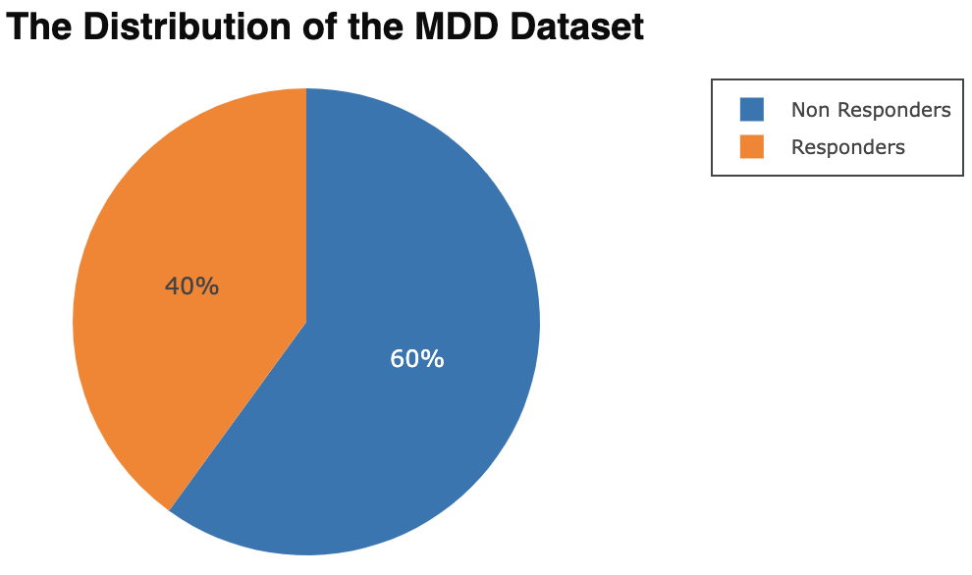
Data Set
For this research utilized the MDD Patients and Healthy Controls EEG Data, acquired from Figshare. Particularly focusing on the EC (Eyes Closed) .edf files.
The dataset comprises a total of 30 EC .edf files, including 12 files for responders and 18 files for non-responders.

Slide 10
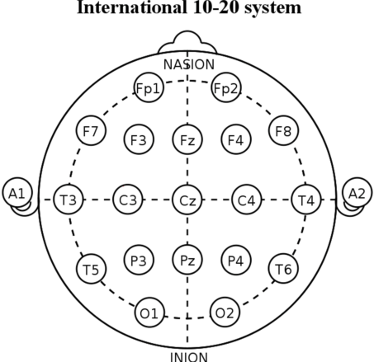
Data Set
The EEG data were recorded for a duration of 5 minutes using a linked-ear reference, employing 19-channel electrodes positioned based on the international 10–20 electrode positioning system.
The sample frequency utilized was 256 Hz, and the signals were band-pass filtered within the range of 0.5–70 Hz. Additionally, a notch filter at 50 Hz was applied to eliminate power line noise.

Slide 11
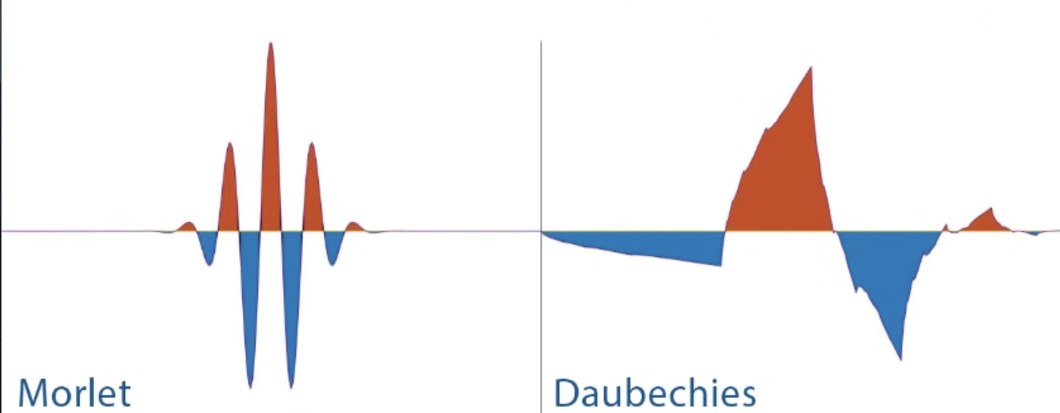
Data Processing
Preprocessed responders and non-responders EEG signals, into time-frequency images using three distinct methods: WSST, CWT, and DWT, thereby generated three separate datasets. Each dataset consists of Responders –2166 and Non-Responders – 3249 images.
EEG signal channels are segmented into 30-second intervals.
Segmented channels are transformed into WSST time-frequency images with a sampling frequency of 256 Hz using the Morlet wavelet as the mother wavelet.

Slide 12
Data Processing
CWT with Morlet wavelet is applied to extract time-frequency information, configuring a sampling frequency of 256 Hz and a frequency range from 0.5 Hz to 20 Hz.
DWT with 'db4' wavelet and level 5 decomposition is applied to extract time-frequency representations, capturing frequency components at various scales and bands.

Slide 13
Data Processing
Dataset is divided into 80% (training and validation) and 20% testing. To mitigate bias and ensure a robust evaluation of our proposed models, implemented a 5-fold cross-validation strategy.
The pixel values are normalized in range [0, 1].
The input size specified for our model is (224, 224).

Slide 14
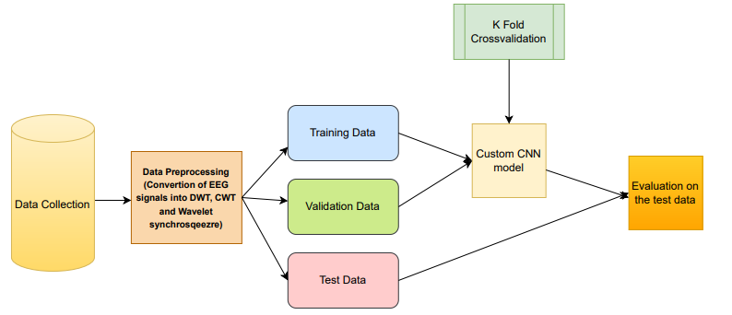
Research Design(Blueprint/Workflow)

Slide 15
Research Design(Blueprint/Workflow)
Obtained MDD patients and Healthy Controls EEG Data from Figshare to distinguish responders from non-responders to medication.
The main focus of research is on employing time-frequency approaches such as wavelet synchro squeezing to predict pharmaceutical response.
Generated images from EEG signals to develop computationally efficient and high performining CNN model.
Data was split into sets for testing, training, and validation; 5-fold cross-validation was used to provide a reliable model evaluation.
Accuracy, F1 Score, and AUC are used to measure performance and analyse the CNN models' predictive power.

Slide 16
Model Description
Our CNN model consists of:
Four convolutional layers with ReLU activation functions. Each convolutional layer is followed by batch normalization for regularization. Filter sizes of 4, 6, 8, and 12, respectively, with kernel sizes of (3, 3).
A dropout layer with a dropout rate of 0.25 to prevent overfitting is followed by a dense output layer with a sigmoid activation function for binary classification.
The model employs the Adam optimizer with a learning rate set to 0.0001, utilizes binary cross-entropy loss function during training, and incorporates early stopping with a patience of 3 for regularization.

Slide 17
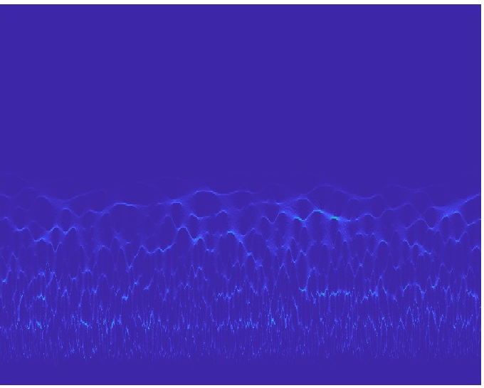
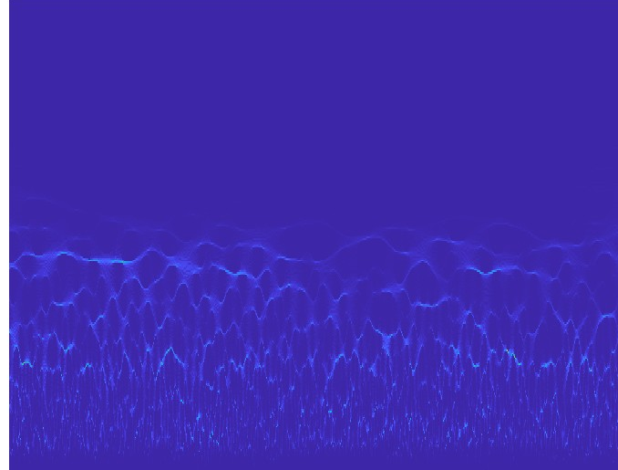
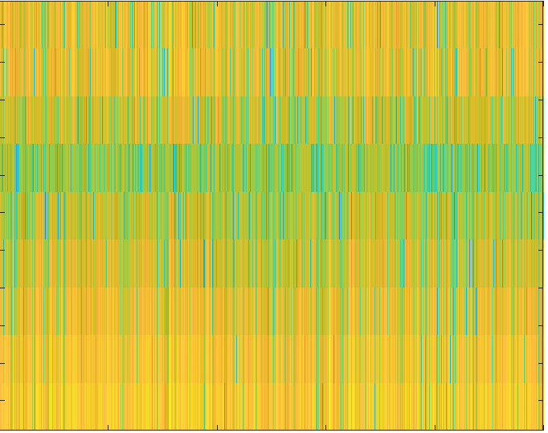
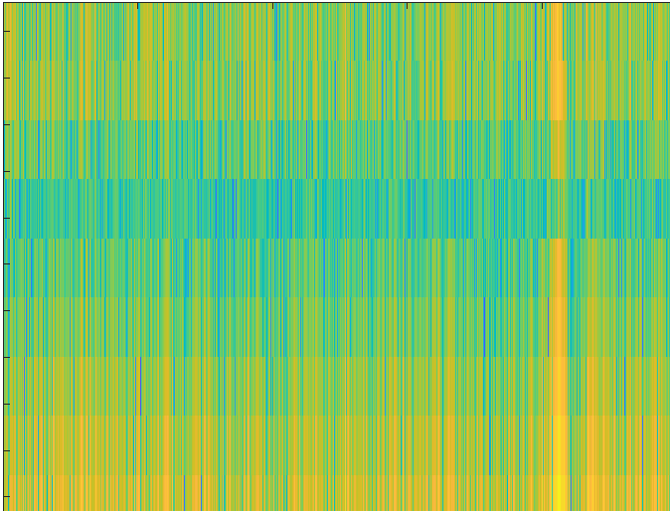
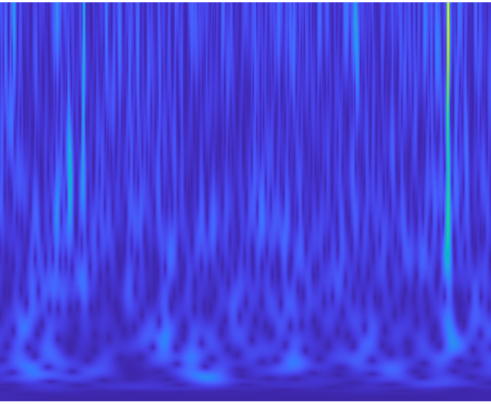
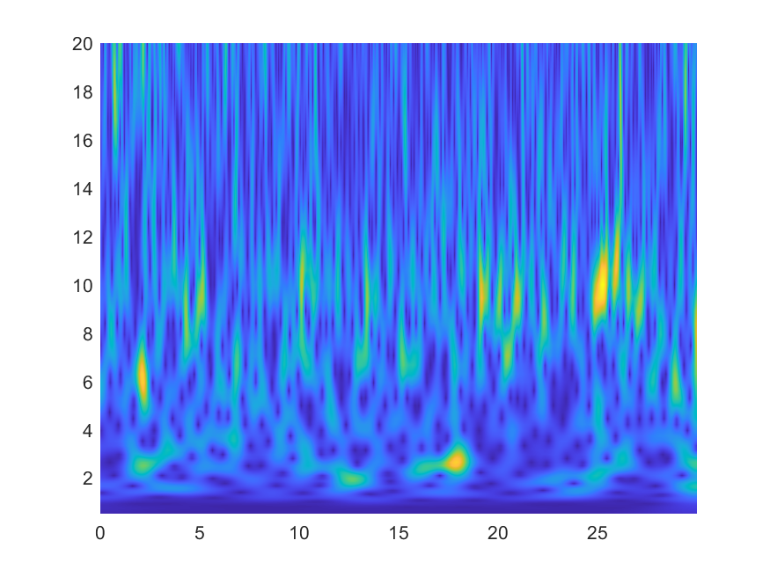
Data Analysis and Data Visualization
Time Frequency Method
Responders
Non-Responders
Wavelet Synchro squeezing
Discrete Wavelet Transform
Continuous Wavelet Transform

Slide 18
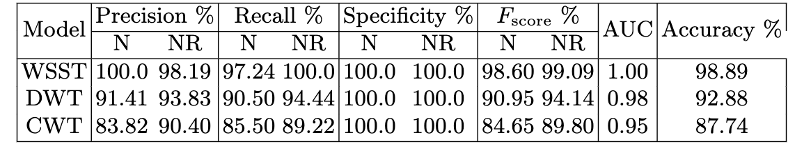
Results
WSST excels in EEG signal extraction, achieving top accuracy of 98.89%, following with DWT with an accuracy of 92.89% and CWT with an accuracy of 87.74%.
From the above results we can conclude that WSST method is performing well when compared to CWT and DWT.

Slide 19
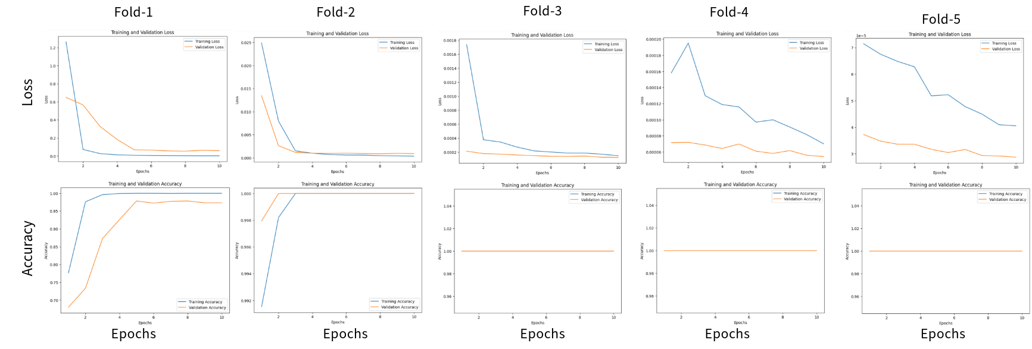
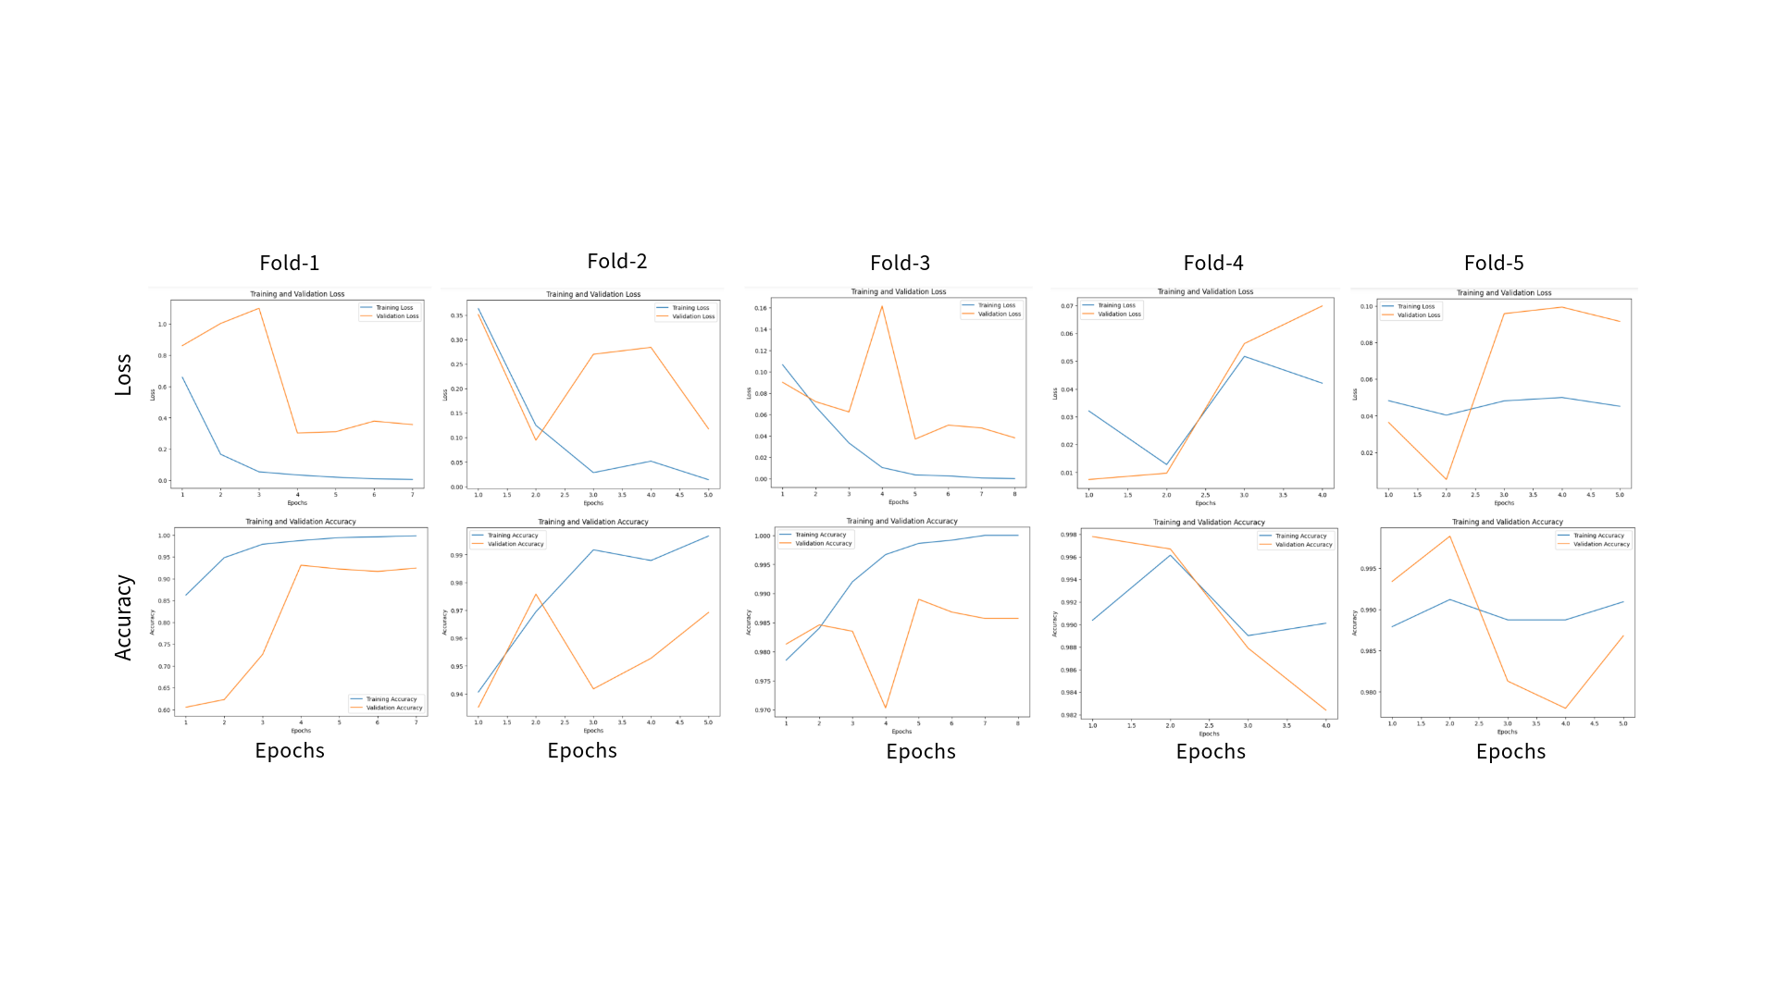
Results
Wavelet Synchrosqueezing
Discrete Wavelet Transform​
Continuous Wavelet Transform​

Slide 20
Results
Comparison with related works
Study | Methods | Results
Mumtaz et al, 2017 | Machine Learning | ACC = 91.6%
Mohsen Sadat Shahabi et al, 2021 | Ensemble of CNN and TL models | ACC = 96.55%
Ahmad Shalbaf et al, 2022 | Ensemble of TL and LSTM Attention | ACC = 98.21%
Behrouz Nobakhsh et al, 2022 | Machine Learning | ACC = 89.6%
Reza Kazemi et al, 2023 | Ensemble of TL and BLSTM Attention | ACC = 98.86%
Our proposed model | CNN (WSST) | ACC = 98.89%

Slide 21
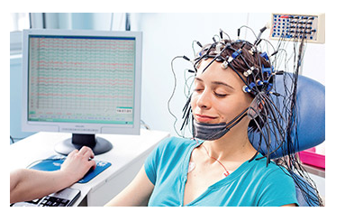
Conclusion
Our research revealed that WSST performed well with our model compared to other time-frequency methods. WSST time-frequency images aided our model in effectively capturing intricate information, enhancing training efficiency.
Through our research, proposed a computationally efficient and high-performance CNN compared to other transfer learning and hybrid models.

Slide 22
References
Shahabi, M. S., & Shalbaf, A. (2022). Prediction of treatment outcome in major depressive disorder using ensemble of hybrid transfer learning and long short term memory based on EEG signal. IEEE Transactions on Cognitive and Developmental Systems.
Shahabi, M. S., Shalbaf, A., & Maghsoudi, A. (2021). Prediction of drug response in major depressive disorder using ensemble of transfer learning with convolutional neural network based on EEG. Biocybernetics and Biomedical Engineering, 41(3), 946-959.
Shahabi, M. S., Shalbaf, A., Nobakhsh, B., Rostami, R., & Kazemi, R. (2023). Attention-based convolutional recurrent deep neural networks for the prediction of response to repetitive transcranial magnetic stimulation for major depressive disorder. International Journal of Neural Systems, 33(02), 2350007.
Nobakhsh, B., Shalbaf, A., Rostami, R., Kazemi, R., Rezaei, E., & Shalbaf, R. (2023). An effective brain connectivity technique to predict repetitive transcranial magnetic stimulation outcome for major depressive disorder patients using EEG signals. Physical and Engineering Sciences in Medicine, 46(1), 67-81.
Mumtaz, W., Xia, L., Mohd Yasin, M. A., Azhar Ali, S. S., & Malik, A. S. (2017). A wavelet-based technique to predict treatment outcome for major depressive disorder. PloS one, 12(2), e0171409.

Slide 23
Thank You

